Slide 1
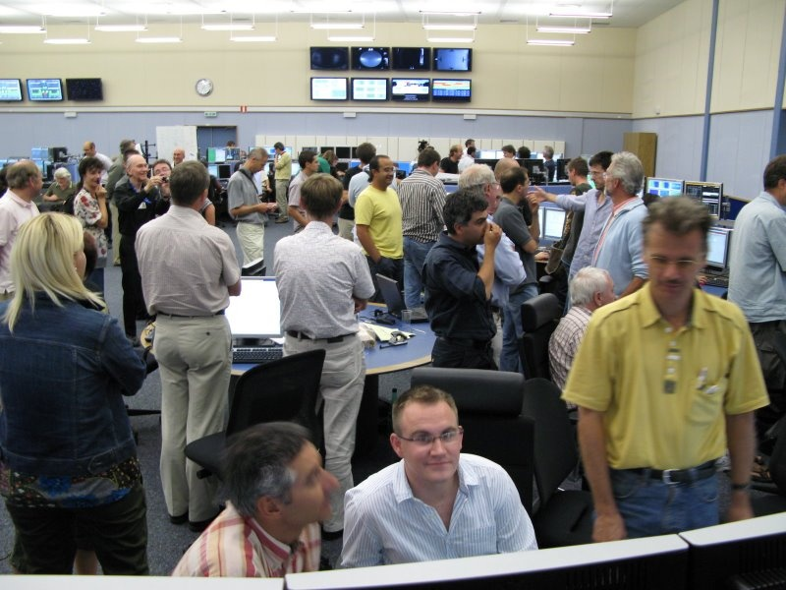
Injection test 2

Slide 2
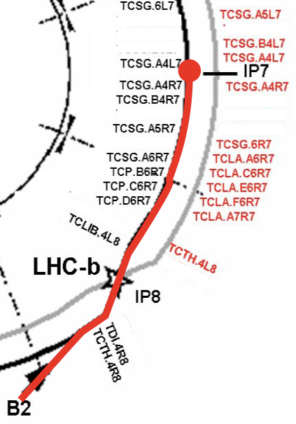
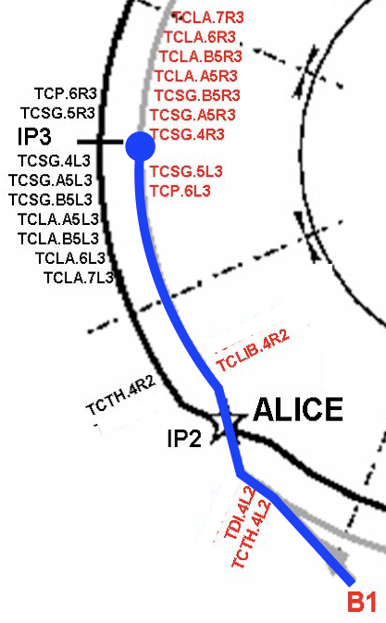
Injection test 2

Slide 3
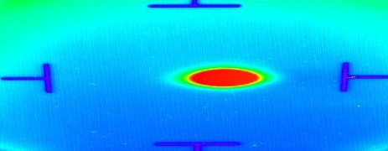
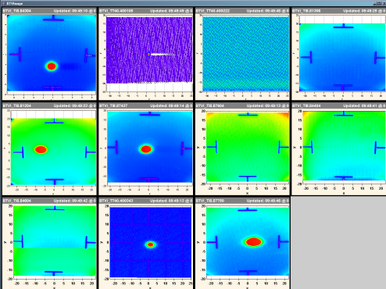
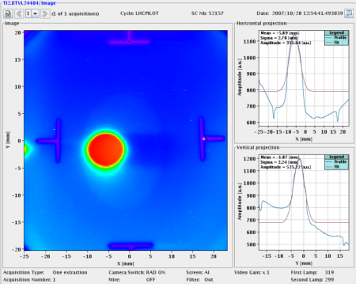
Preparation
TT40 – Sept/Oct 2003
TI8 – Sept 2004
TI2 - 2007
LTI, LSA, OP, CO & co

Slide 4
Preparation
Extraction, TI2 | Checkout and pluse
Injection septa, kickers | Pulse elements, soft start tests
RF synchro – pre-pulses | Extraction/Injection tests
Timing System | Injection requests, events etc etc
Beam Interlock System | Interface to Vacuum, PIC, WIC etc etc
Collimators | Controls tests plus Hardware interlocks
Vacuum | Interlock tests, valves out
TDI & TCDD | IST, Controls tests
BLMs | Acquisition, PIC, thresholds
BPMs | “BeamThreading” - test
BPM – sum signal | Q8.R2, Q8.L3
BTVs | Tests, calibration etc.
BCT | Test
RADMON | Controls tests
RAMSES | Check
Logging
Alarms
LSA/Settings etc
YASP
Controls Infrastructure
Magnet model
Optics/Aperture
On-line model
Sequencer
Software Interlocks
Plus an impeccable cold checkout c/o Gianluigi, Rossano & co
plus warm & cold magnet tests…
plus access and DSO tests

Slide 5
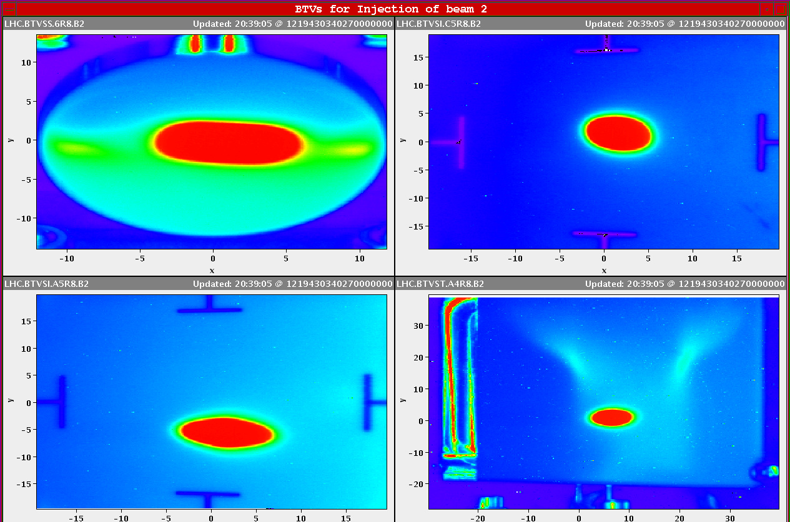
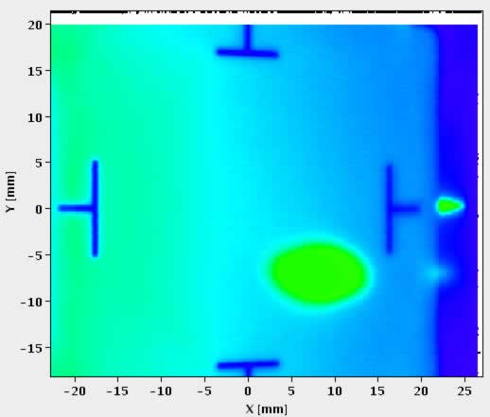
Friday evening
Beam to TDI
Beam to IR7

Slide 6
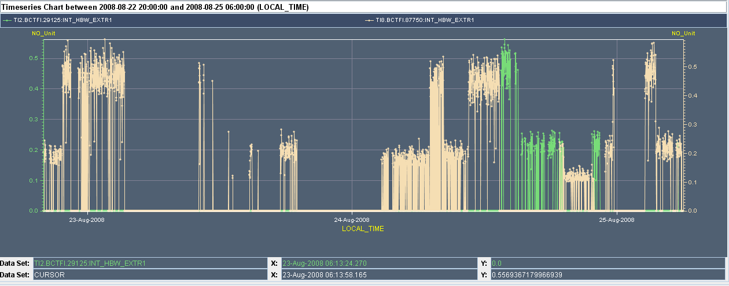
Beam over the weekend

Slide 7
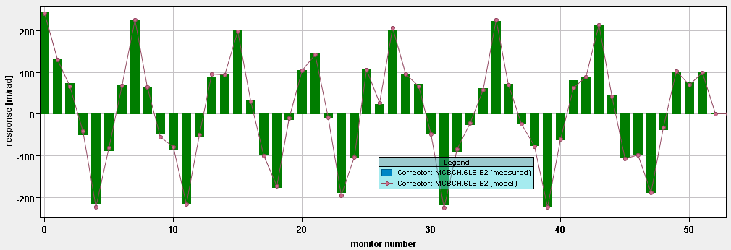
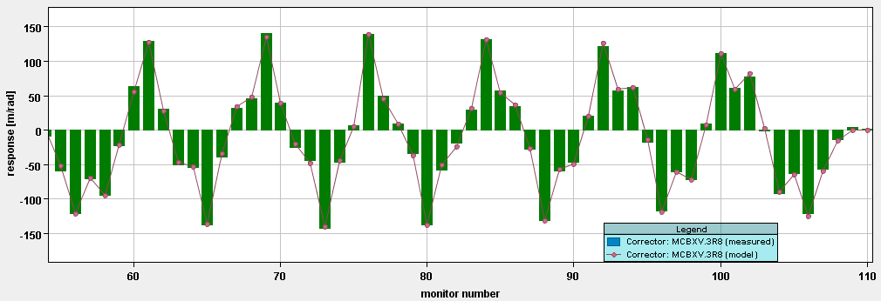
S78 - Arc
S78 / Friday night data : lot’s of BPM errors in the straight section → arc only.
The arc phase advance looks OK: fit changes H/V strengths by 0.4%/0.2%.
K. Fuchsberger / J. Wenninger

Slide 8
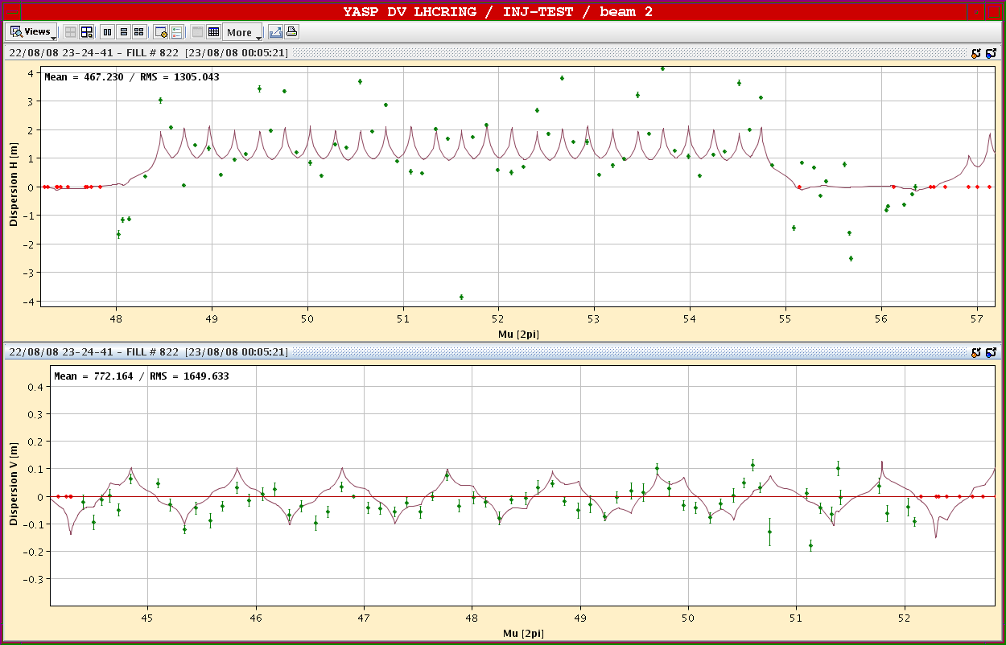
Dispersion in TI 8 and LHC78
Original
M.Meddahi, I.Agapov, B.Goddard, V.Kain, T.Risselada, V.Mertens, …

Slide 9
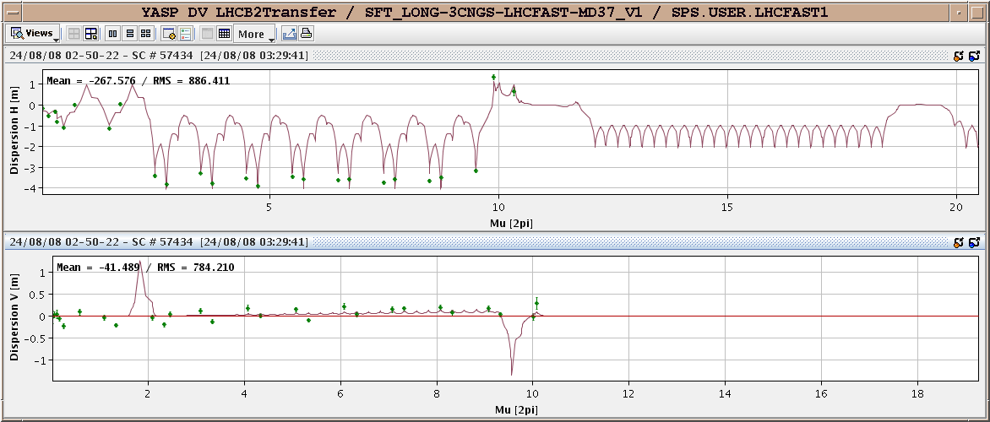
Re-matched TI8
Malika

Slide 10
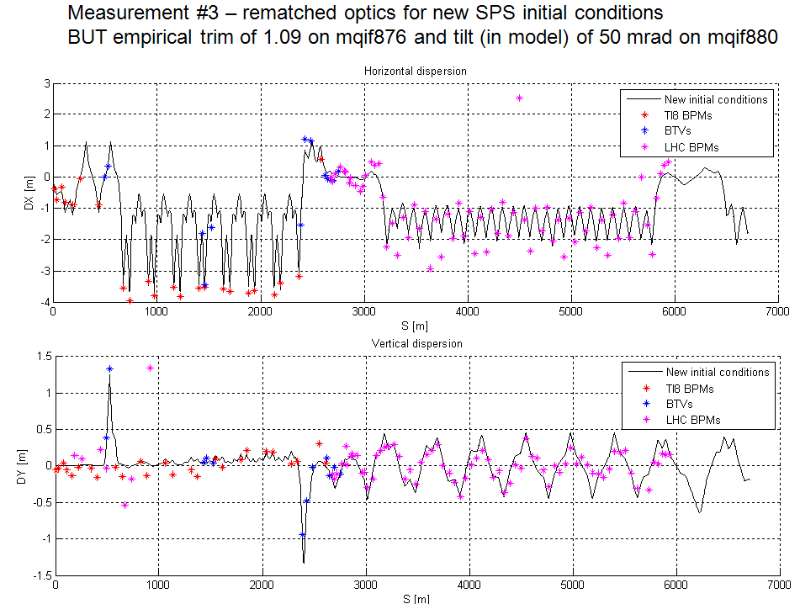
Dispersion continued
Brennan Goddard

Slide 11
Dispersion
Brennan Goddard

Slide 12
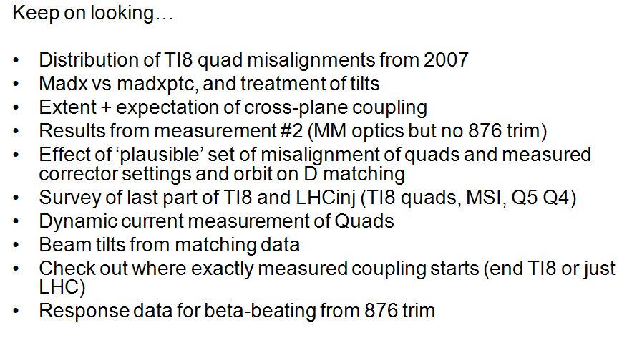
Follow-up
Brennan Goddard

Slide 13
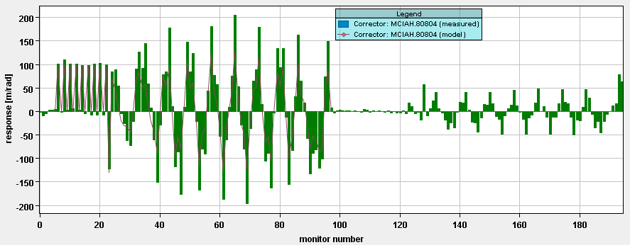
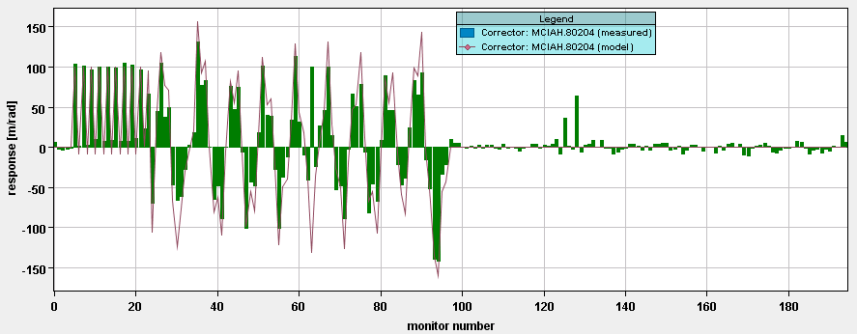
TI8 + S78
Horizontal
Vertical
Strong coupling for this phase !!
Error ~ end of TI8 not a trivial gradient error !!
BPMS

Slide 14
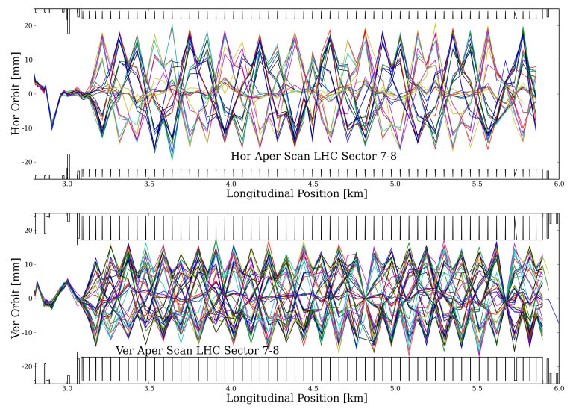
Friday night
I. Agapov, R. Calaga, S. Redaelli, R. Tomàs, M. Giovannozzi et al.

Slide 15
Aperture H-scan example
19 σ free oscillation, 60º
Q6R7
Q10R7
Q20L8
Q28L8
Q16L8

Slide 16
Aperture – prelimary conclusions
Horizontal aperture is around ±18 mm (confirmed value measured in first injection test).
Vertical aperture is around ±12 mm (slightly larger than in first injection test).
I. Agapov, R. Calaga, S. Redaelli, R. Tomàs, M. Giovannozzi et al.

Slide 17
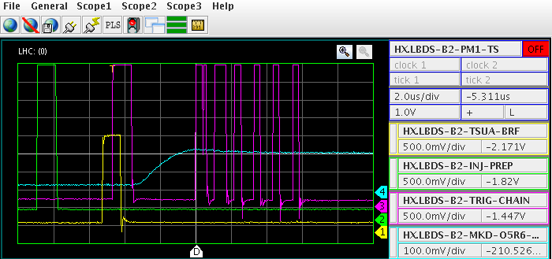
Inject and dump
Etienne Carlier

Slide 18
Polarity checks
Frank Zimmermann, Rama Calaga, Verena Kain, Mike Lamont, Laurette Ponce, Rogelio Tomas
Basic procedure:
launch betatron oscillations with single orbit corrector
change strength or polarity of circuit under investigation,
for sextupole circuits change momentum offset of injected beam
Data taken for following S78 beam-2 circuits:
RSD1&2, RSF1&2, MCS, MSS (soff-momentum)
QTL11L8, QT12L8, QT13RL8
MQS
OD, OF (on and off-momentum)

Slide 19
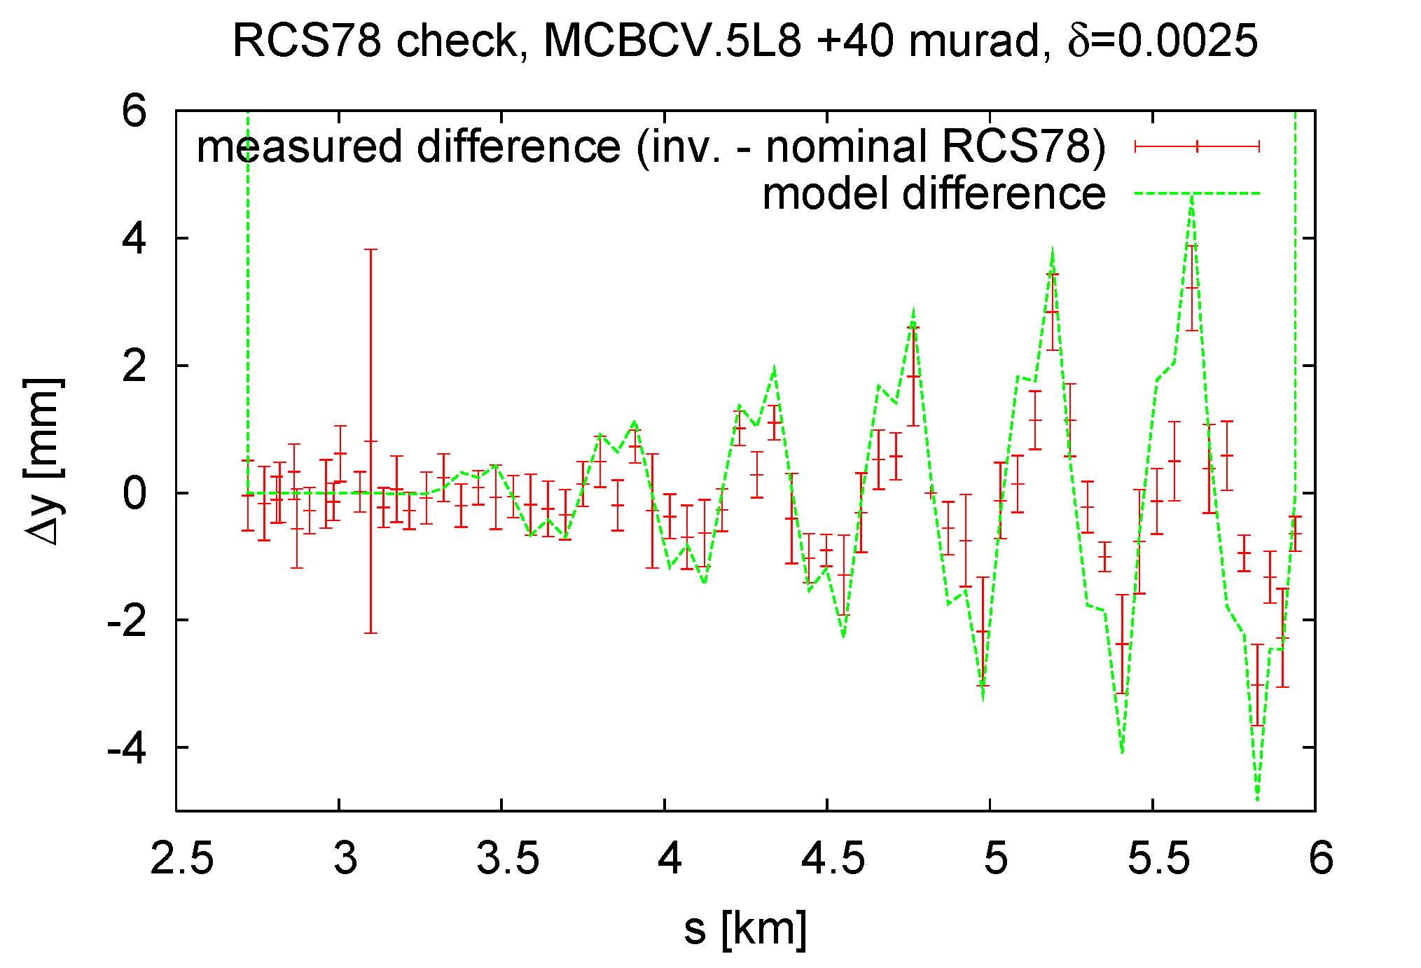
plot difference to reveal effect of b3 spool pieces
excellent agreement with model → MCS correct sign & strength
Frank, Rama, Rogelio

Slide 20
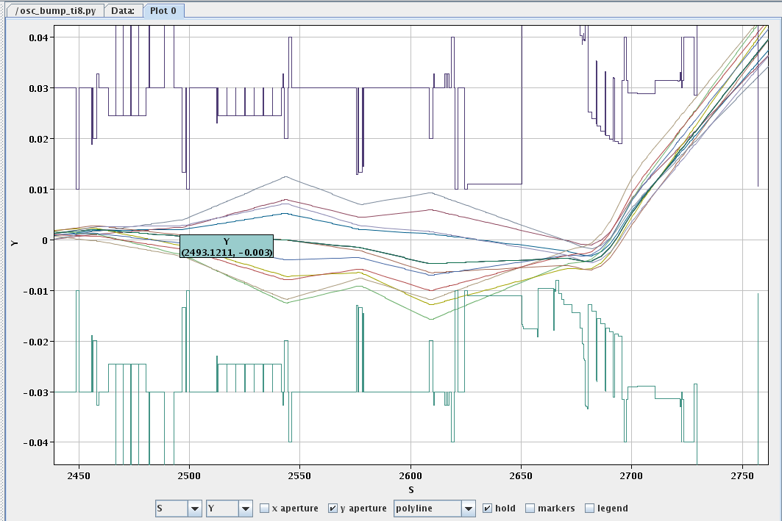
Aperture measured in point 8 injection – vertical
Again see asymmetry from trajectory -
I.Agapov, B.Goddard, J.Uythoven, M.Meddahi, V.Mertens,

Slide 21
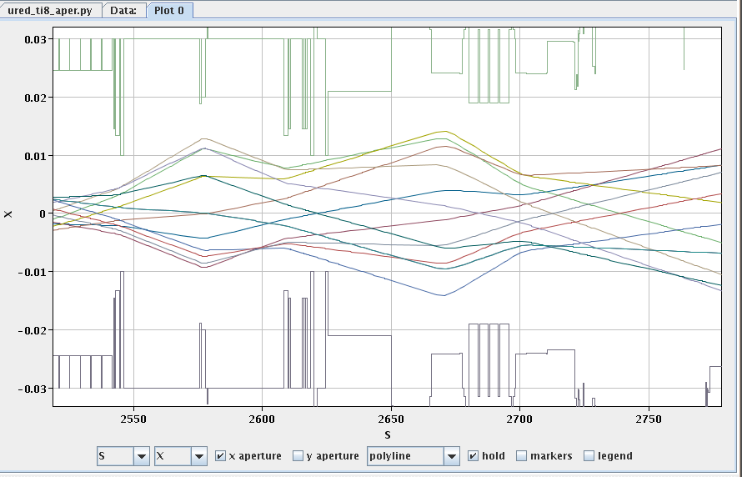
Aperture measured in point 8 injection – horizontal
See about 2 mm asymmetry - almost certainly from trajectory.
I.Agapov, B.Goddard, J.Uythoven, M.Meddahi, V.Mertens,

Slide 22
Aperture in 8 - conclusions
Looks good
±8 sigma in H, ~6 sigma in V at main limits
Will add trajectories to data for ‘final’ version
Maybe need to add BLMs at Vac valve upstream of TDI
Clear limit if MKI is off – no loss monitoring here
I.Agapov, B.Goddard, J.Uythoven, M.Meddahi, V.Mertens,

Slide 23
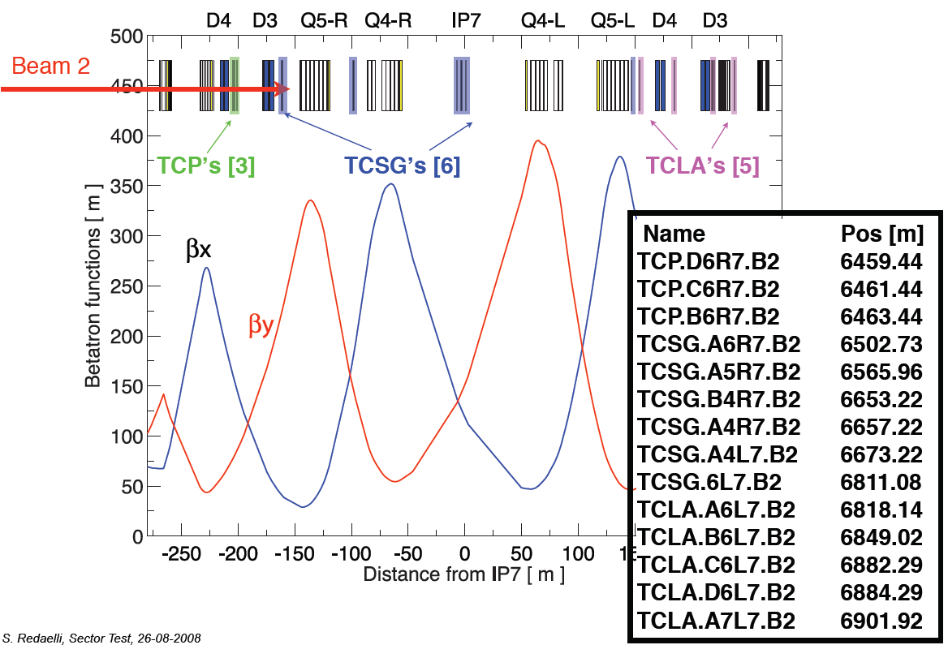
BLM response in IR7

Slide 24
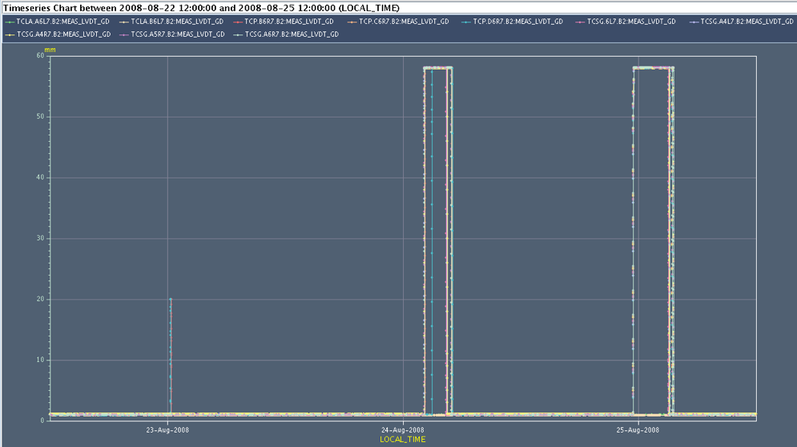
Collimator gaps during the test
Closed: 1 mm gap
Open some collimators to commission the warm IP7
Stefano Redaelli

Slide 25
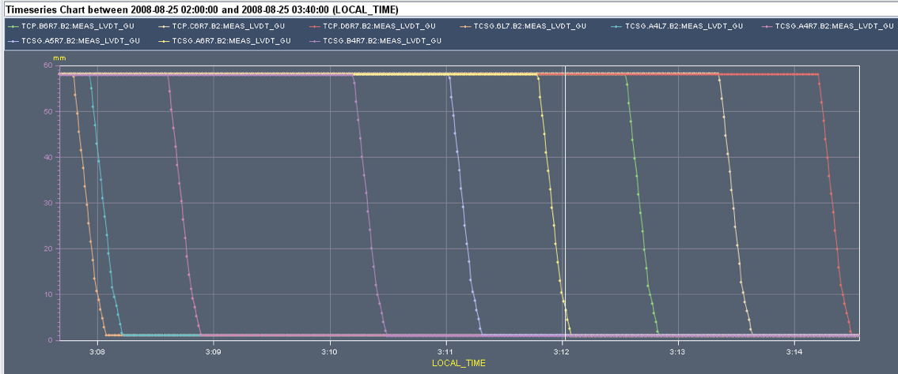
Collimator gaps during BLM response
Close one at a time all the Carbon collimators to verify the BLM response
Stefano Redaelli

Slide 26
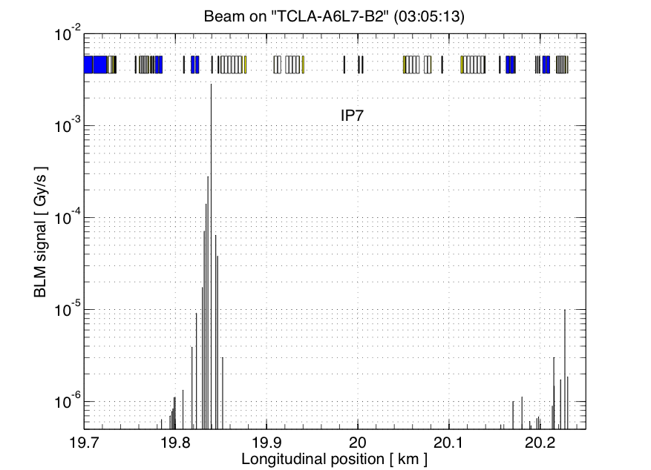
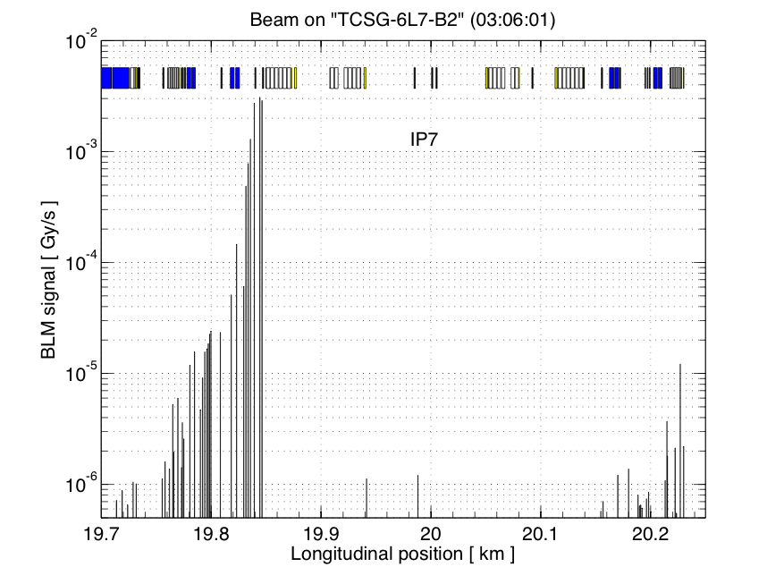
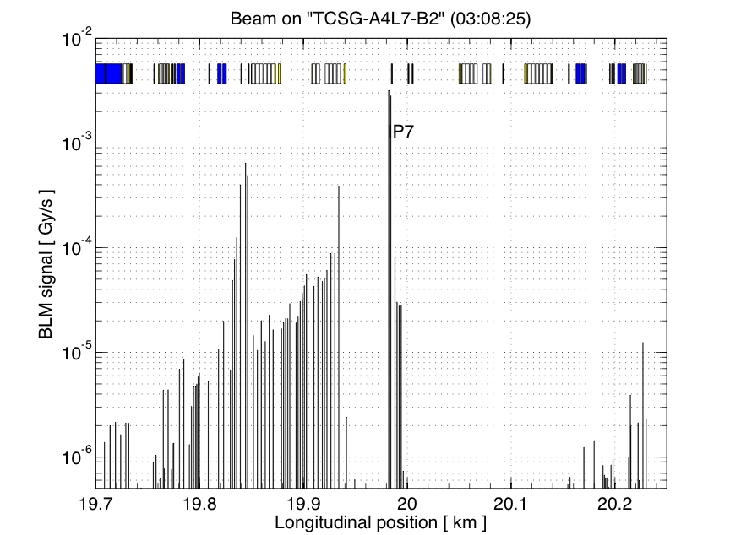
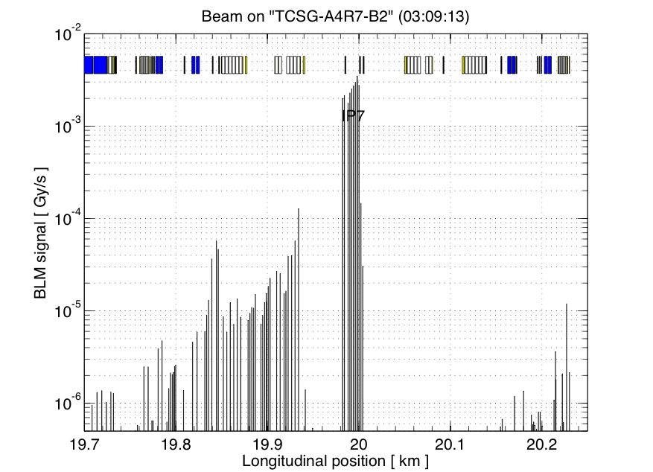
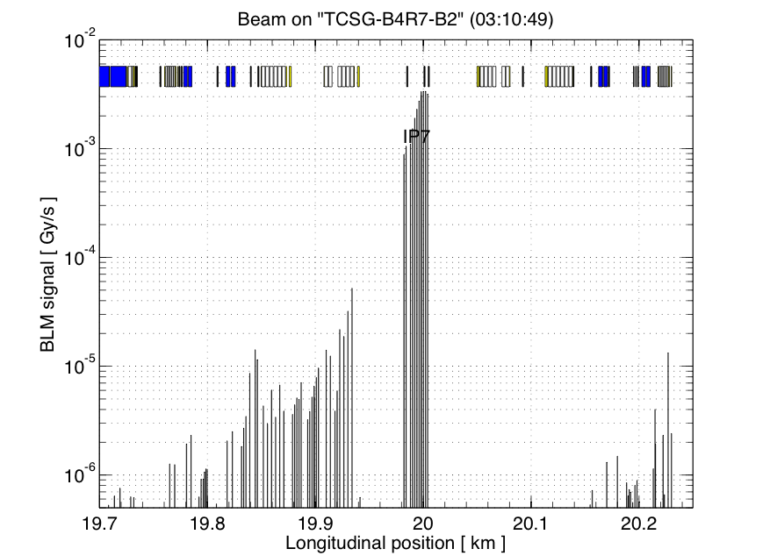
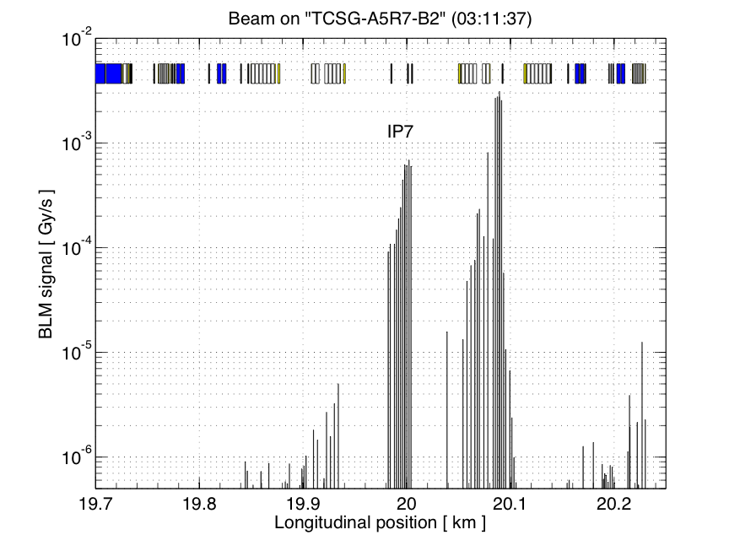
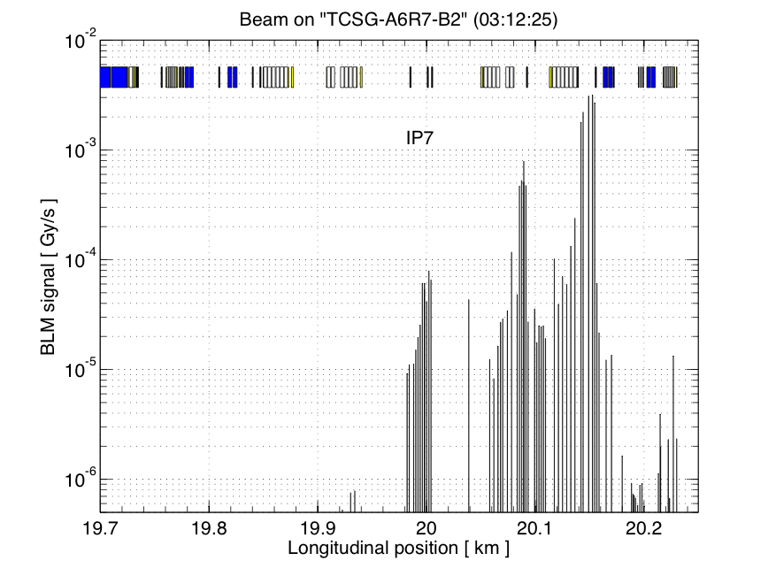
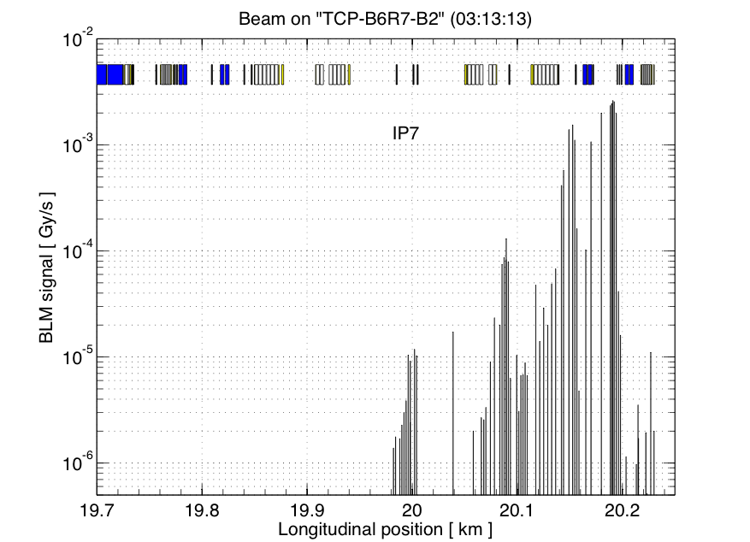
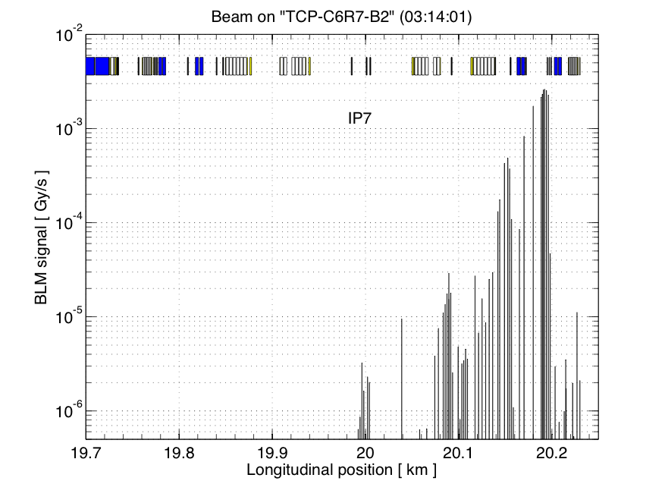
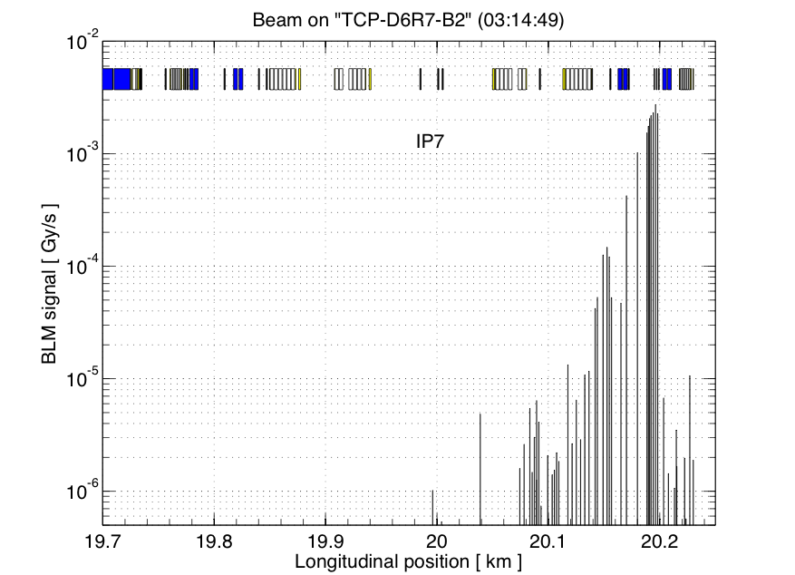
Preliminary Results – analysis in progress
Beam 2

Slide 27
BPMs

Slide 28
23 revisted

Slide 29
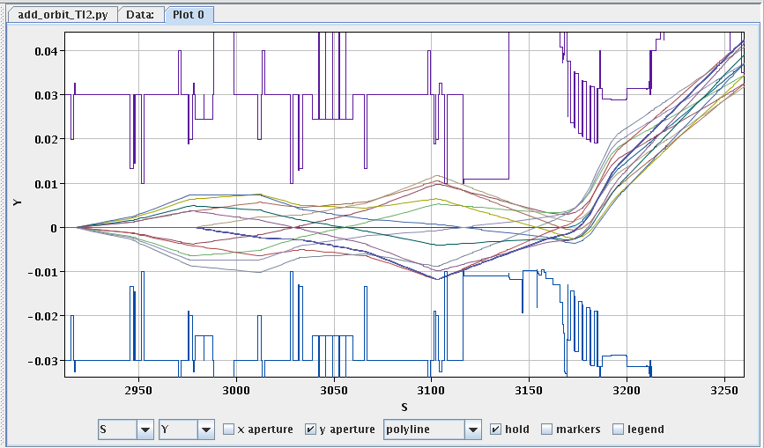
Aperture measured in point 2 injection – now as expected….
Vac Valve between MSI and Q5 realigned – now looks good.

Slide 30
Dispersion 23 (1)
Changes of polarity of the odd QTLs solved point 3 issue, measured also IR3 (TCSG.5L3.B1 was out)
Less good in the arc now...
Results from weekend 8/9 of August
Verena Kain

Slide 31
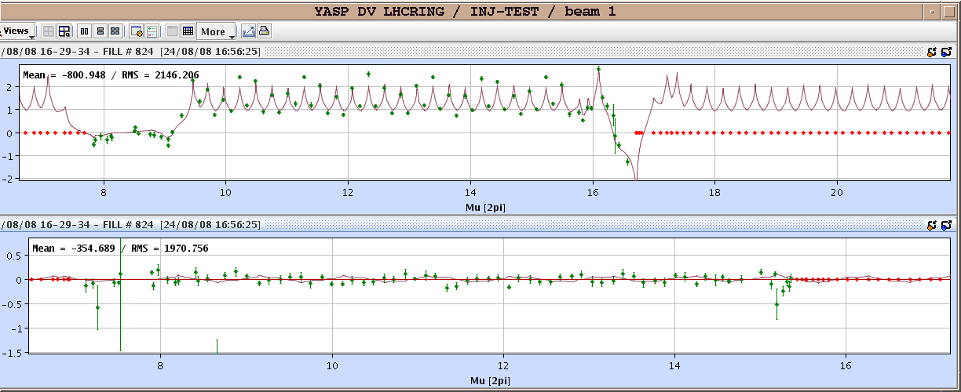
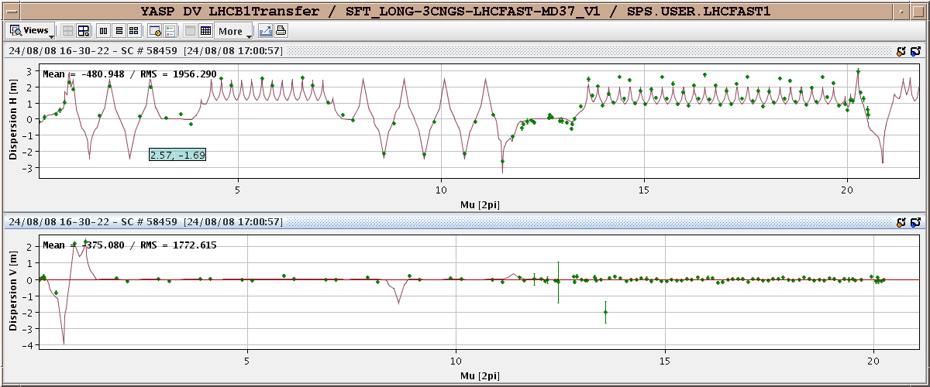
Dispersion 2-3
Results from weekend 23/24 of August

Slide 32
Interleaved injection
Interleaved injections point 2, point 8.
Beam 1 energy error -0.76 per mil
Beam 2 energy error 0.5 per mil
plus CNGS all weekend

Slide 33
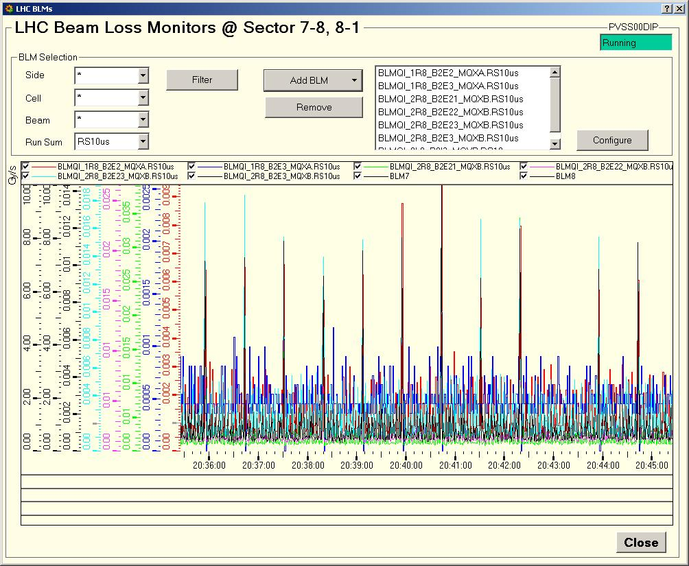
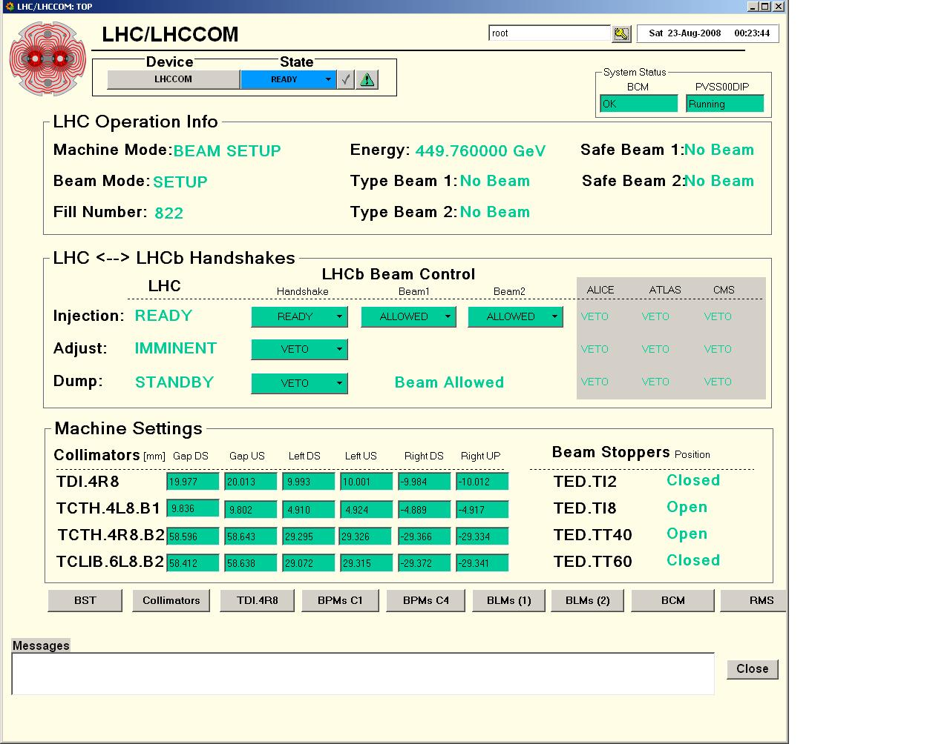
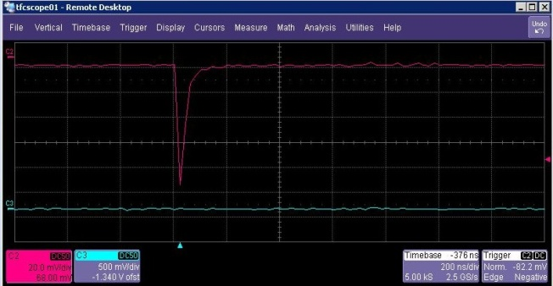
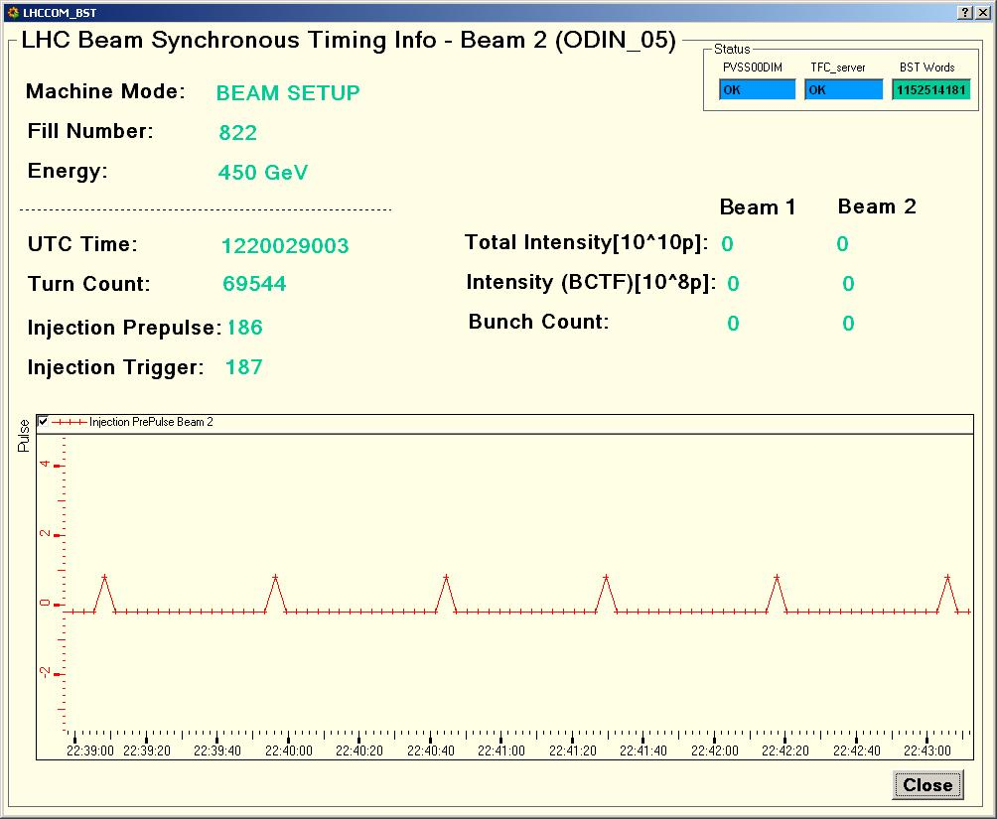
Sector test - Very useful to LHCb
Commissioning hw/sw interfaces with LHC
Beam Loss Scintillator

Slide 34
LHCb

Slide 35
Acknowledgements
Hardware Commissioning Coordination (HCC)
Survey group
Access System team
Cryogenics
Magnets [PO, MPP, QPS, PIC...]
Accelerator systems:
Injection team,
beam instrumentation, (BPM, BLM, BCT,screens ...),
beam interlock system,
radio-protection,
collimators,
controls ...
Contributions of everyone who participated and support the injection test again

Slide 36
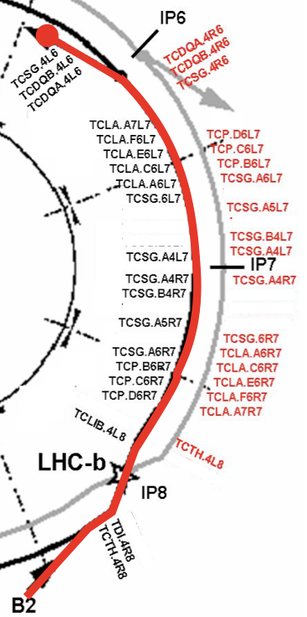
Injection test 3
Evening Friday 5th – morning Monday 8th
Beam from IP8 to beam dumping system
as detailed in this year’s ELTC
Use opportunity to also perform full-scale dry run of whole LHC in preparation for the 10th

