Slide 1
Injection Test : Status of the Beam Interlock System
Injection Test Preparation meeting / July 22, 2008 / B.Puccio

Slide 2
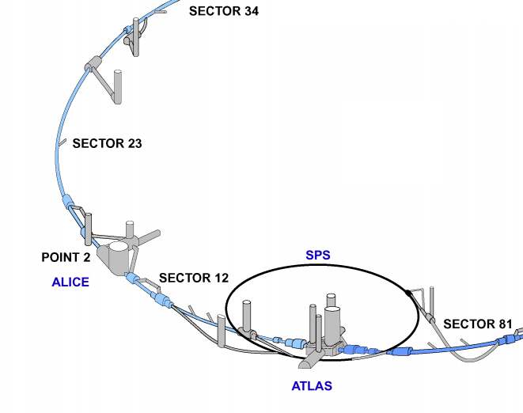
BIS Hierarchy
User Permits
(L2, R2,
Left 3)
BIS for
LHC ring1
LHC Beam Permit
LBDS 1
Injection
BIS
(beam-1)
Injection Permit
MKI 2
User Permits
(IR 2)
Extraction
BIS
(beam-1)
Extraction Permit
MKE 6
User Permits
TT60 & Ti2
Injection Test Preparation meeting / July 22, 2008 / B.Puccio

Slide 3
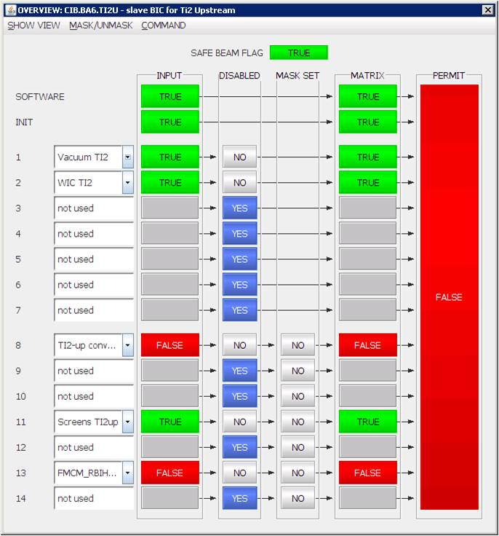
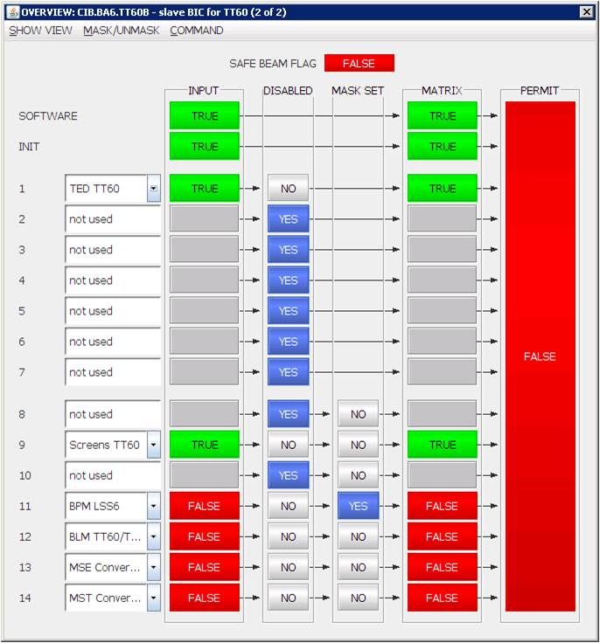
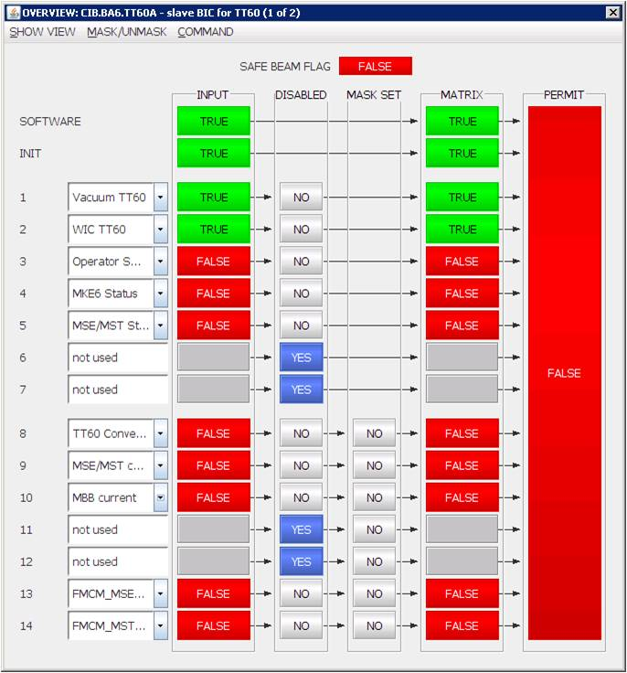
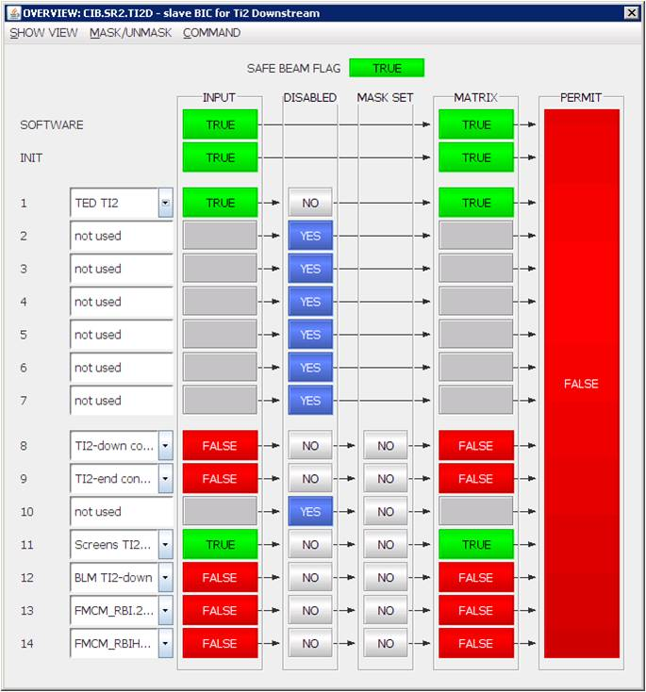
Extraction BIS (1 of 2)
User Permits from:
TT60-TED
Ti2-TED
- Vacuum TT60 & Ti2
- WIC TT60 & Ti2
- Operator Switch
- MKE6 status
- MSE/MST Status
- Power Converters
- FMCM (MSE, MST,…)
- Screens TT60 & Ti2
- BPM LSS6
- BLM TT60/Ti2
Injection Test Preparation meeting / July 22, 2008 / B.Puccio
up to TI2 TED: all channels already tested C
PCs and FMCMs after TED to be tested (Maskable => not critical )

Slide 4
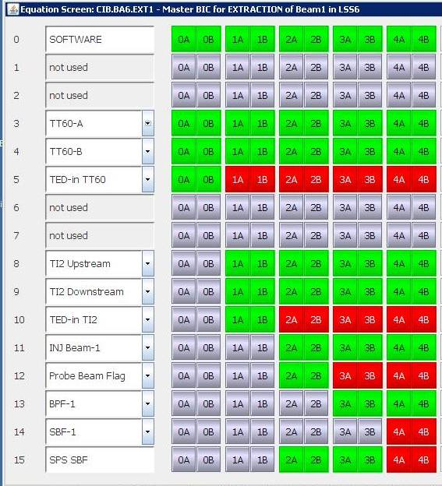
Extraction BIS (2 of 2)
Additional User Permits for the Master BIC:
- Ti2 TED
- SPS Probe_Beam_Flag
LHC Safe_Beam_Flag
Injection Permit
Injection Test Preparation meeting / July 22, 2008 / B.Puccio
Mandatory: Test of Probe_Beam_Flag with SPS beam.
LHC Safe_Beam_Flag must be forced to TRUE for the test.
Test of full Master-BIC logic only be done with TI2 TED out of beam
→ IR2 closed.

Slide 5
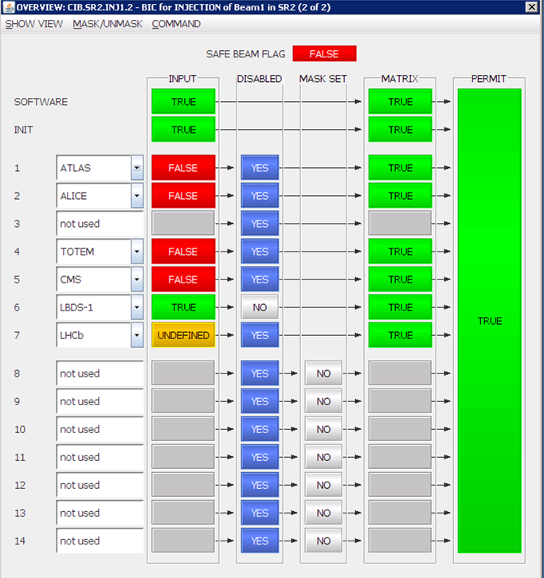
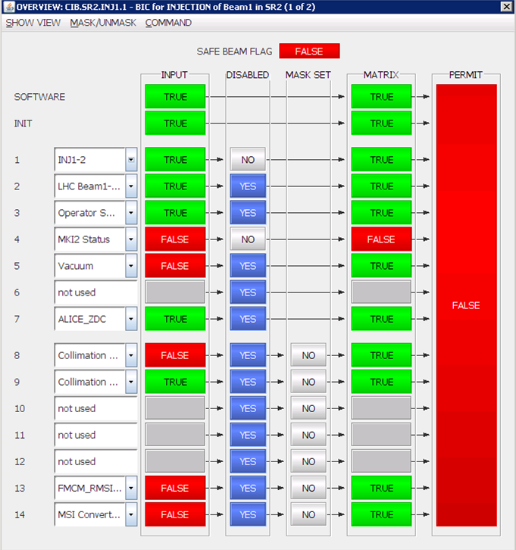
Injection BIS
Mandatory User Permits:
- Vacuum
Operator switch
ALICE (global inhibit)
ALICE ZDC
LHC Beam Permit
Nice to have…
Collimators
- MSI Power Converter
FMCM (MSI)
Disabled channels:
ATLAS
CMS
LHCb
LBDS-1
Injection Test Preparation meeting / July 22, 2008 / B.Puccio
CAll above channels already commissioned.
Experiments Injection Inhibits: only ALICE is enabled
(ATLAS, CMS, etc… not activated).
According to Jorg:
Nice to have Collimators…. (Maskable channel)

Slide 6
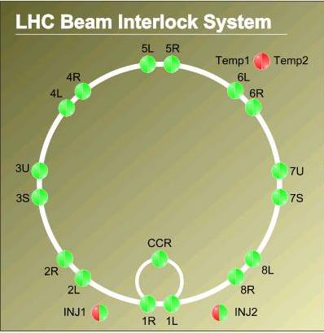
LHC-ring BIS (1 of 2)
All channels disabled on:
BIC.R4, BIC.L4,
BIC.R5, BIC.L5,
BIC.R6, BIC.L6,
BIC.U7, BIC.S7,
BIC.R8, BIC.L8,
BIC.R1, BIC.L1
Injection Test Preparation meeting / July 22, 2008 / B.Puccio
We keep the Beam Permit loops in place
Activate only required User inputs:
5 BICs (L2, R2, UJ33, SR3 & CCR) are involved
Other BICs not implicated in the Beam Permit => User Permits inputs disabled

Slide 7
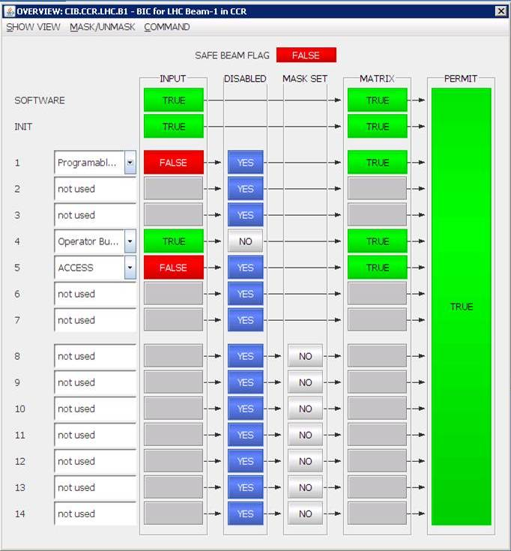
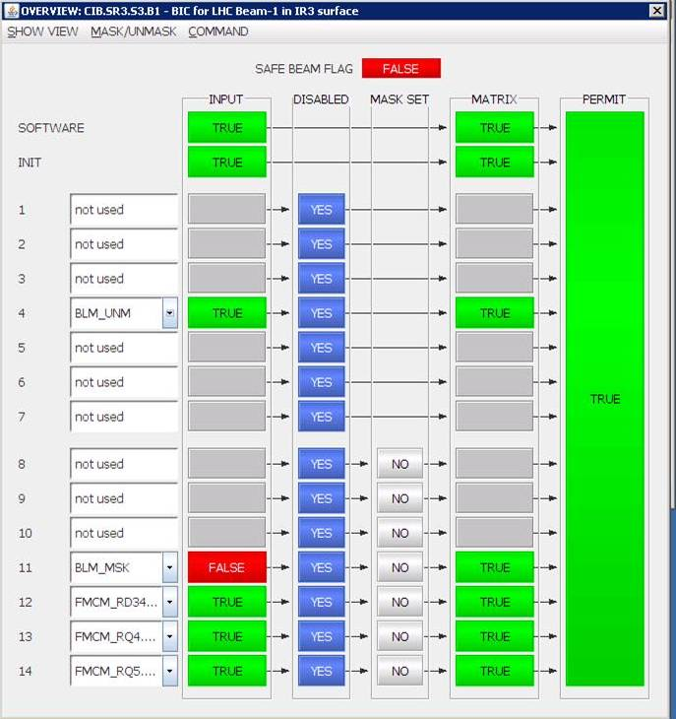
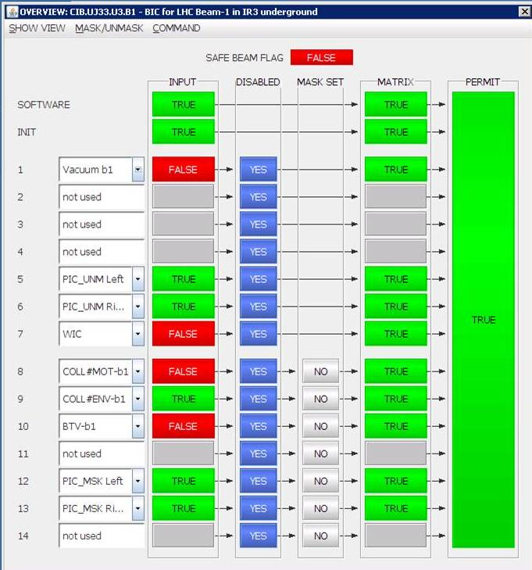
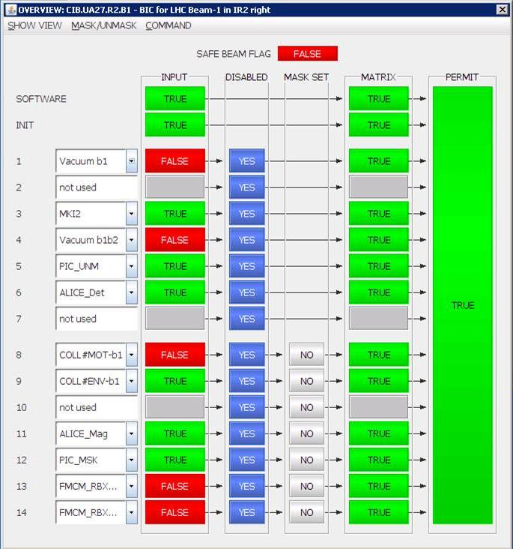
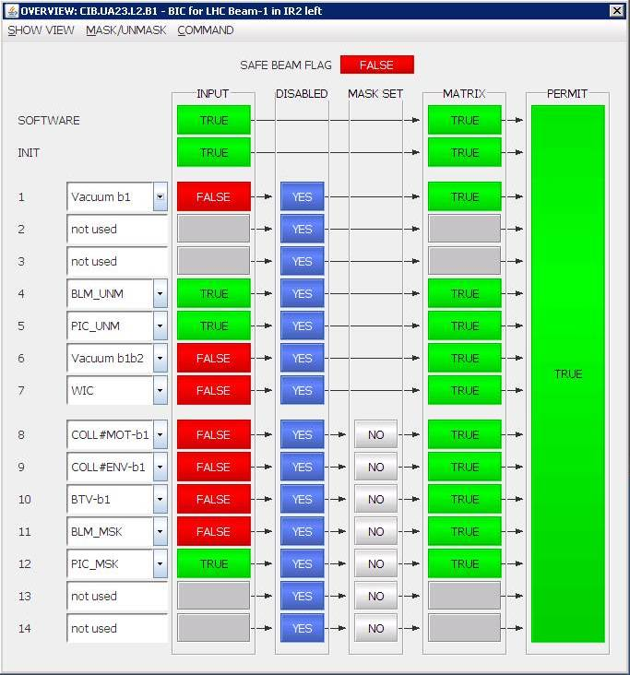
LHC-ring BIS (2 of 2)
Mandatory User Permits:
Vacuum
PICs
WICs
Operator switch
Access
Nice to have…
BLMs
Collimators
- MSI Power Converter
FMCM
BTVs
Injection Test Preparation meeting / July 22, 2008 / B.Puccio
All above channels already commissioned: C
BLMs (Unmaskable): Should be ready. Connect if possible, else only observation.
BTVs: Expected to be ready. Could be masked if we don’t use them!

Slide 8
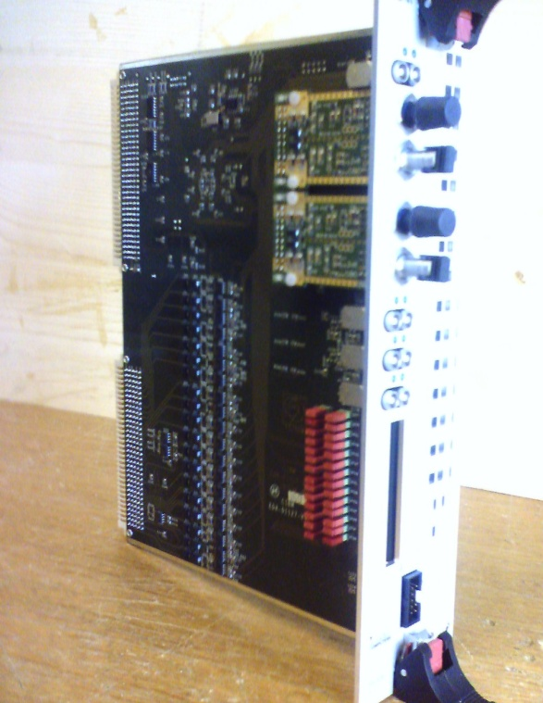
Disabling process:
CIBM: BIS Manager Board
On-board
“disabled jumpers”
are usually used
for non-used
Input channels
Injection Test Preparation meeting / July 22, 2008 / B.Puccio
In order to have the local Beam Permit, we disable all inputs in putting on the on-board jumpers on the corresponding BIC.
Note: not possible during normal Operation as jumpers position must match the Configuration file.

Slide 9
SIS for Injection inhibit beam1:
PC states: Ready to be tested.
MCBX currents: Ready to be tested. Quick test .
RD1/RD2 currents: Ready to be tested. Quick test.
BTVs: Configuration not final
Injection Test Preparation meeting / July 22, 2008 / B.Puccio

Slide 10
Test Plans…
today
Carry on the BIS preparation for circulating beams:
Complete commissioning part with Users systems
endurance test, UTC alignment, improvement of monitoring software,...
in //: Perform tests with key systems: VAC, PIC,…
(re)Check connection with Access system
Test of the Probe_Beam_Flag with SPS beam
? of August => Disable all channels that are not ready in Injection Test
☞ LHC Safe_Beam_Flag forced to TRUE
BIS ready for Injection Test:
Test of PCs and FMCMs after Ti2-TED
Test of full Master-BIC logic (only be done with TED out)
Check of the User Permits for Injection BIS
Check of the User Permits for LHC-ring BIS
8/9 August

Slide 11
Quick conclusions:
BIS is currently ready for Injection Test
Carry on preparation for circulating beams.
In //: already perform (with OP) check-out with key systems
Few days before 8/9 August: we must finalise which systems are at last not ready => disable corresponding inputs
A period (of x days) is needed for completing the tests before injecting beam
Injection Test Preparation meeting / July 22, 2008 / B.Puccio
see Jorg & Co

Slide 12
end

Slide 13
 | User Systems | L1 | R1 | L2 | R2 | U3 | S3 | L4 | R4 | L5 | R5 | L6 | R6 | U7 | S7 | L8 | R8 | CCR | # |  | Inj1 | Inj2
1 | Collimation (Environmental par.) | o o | o o | o o | o o | o o |  |  |  | o o | o o | o o |  | o o |  | o o | o o |  | 22 |  | • | •
2 | Collimation (Motor positions) |  | o o | o o | o o | o o |  |  |  | o o | o o | o o |  | o o |  | o o | o o |  | 20 |  | • | •
3 | Vacuum system (“sector valves”) | • • |  | • • | • • | • • |  | • • | • • | • • |  | • • | • • | • • |  | • • | • • |  | 24
 | Vacuum system (“X valves”) |  | • | • | • |  |  |  |  |  | • |  |  |  |  | • | • |  | 6 |  | • | •
4 | PIC for essential circuits | • | • | • | • | • • |  | • | • | • | • | • | • | • • |  | • | • |  | 16
 | PIC for auxiliary circuits | o | o | o | o | o o |  | o | o | o | o | o | o | o o |  | o | o |  | 16
5 | BLM at aperture limitations* | • |  | • |  |  | • | • |  | • |  | • |  |  | • | • |  |  | 8
 | BLM in arcs | o |  | o |  |  | o | o |  | o |  | o |  |  | o | o |  |  | 8
6 | Fast Magnet Current Change Mon. | o |  |  | o o |  | ooo |  |  |  | o |  | o o |  | ooo |  |  |  | 12 |  | • | •
7 | Warm Magnets Interlock | • |  | • |  | • |  |  | • | • |  | • |  | • |  | • |  |  | 8
8 | Screens |  |  | o o |  | o o |  |  | o o |  |  |  | o o | o o |  |  |  |  | 8
9 | RF & Transverse Damper |  |  |  |  |  |  | o o | o o |  |  |  |  |  |  |  |  |  | 4
10 | Beam excursion (BPM) |  |  |  |  |  |  |  |  |  |  | o o | o o |  |  |  |  |  | 4
11 | LHC Beam Dumping system |  |  |  |  |  |  |  |  |  |  | • • | • • |  |  |  |  |  | 2 |  | • | •
12 | Operator Buttons |  |  |  |  |  |  |  |  |  |  |  |  |  |  |  |  | • • | 2 |  | • | •
13 | Programmed Beam Dump (via Timing) |  |  |  |  |  |  |  |  |  |  |  |  |  |  |  |  | • • | 2
14 | Safe Machine Parameters |  |  |  |  |  |  |  |  |  |  |  |  |  |  |  |  | • • | 2
15 | Fast Beam current Change Monitor (BCT) |  |  |  |  |  |  |  | • • |  |  |  |  |  |  |  |  |  | 2
16 | Beam Aperture Kicker |  |  |  |  |  |  | • • |  |  |  |  |  |  |  |  | • |  | 2
17 | Injection Kicker |  |  |  | • • |  |  |  |  |  |  |  |  |  |  |  | • • |  | 2 |  | • | •
18 | TCDQ Position |  |  |  |  |  |  |  |  | • • | • • |  |  |  |  |  |  |  | 2
19 | LHC Access Safety System |  |  |  |  |  |  |  |  |  |  |  |  |  |  |  |  | • | 1
20 | ATLAS (movable device) |  | • • |  |  |  |  |  |  |  |  |  |  |  |  |  |  |  | 2
21 | ATLAS (Detector part) |  | • |  |  |  |  |  |  |  |  |  |  |  |  |  |  |  | 1
22 | ATLAS Experiment Magnet |  | • |  |  |  |  |  |  |  |  |  |  |  |  |  |  |  | 1 |  | • | •
23 | ALICE (Detector part) |  |  |  | • |  |  |  |  |  |  |  |  |  |  |  |  |  | 1 |  | • | •
24 | ALICE Experiment Magnet |  |  |  | • |  |  |  |  |  |  |  |  |  |  |  |  |  | 1
25 | ALICE-ZDC (movable device) |  |  |  |  |  |  |  |  |  |  |  |  |  |  |  |  |  | 1 |  | •
26 | CMS Experiment Magnet |  |  |  |  |  |  |  |  |  | • |  |  |  |  |  |  |  | 1
27 | CMS (Detector part) |  |  |  |  |  |  |  |  |  | • |  |  |  |  |  |  |  | 1 |  | • | •
28 | TOTEM (movable device) |  |  |  |  |  |  |  |  |  | • • |  |  |  |  |  |  |  | 2
29 | TOTEM (Detector part) |  |  |  |  |  |  |  |  |  | • |  |  |  |  |  |  |  | 1 |  | • | •
30 | LHCb (Detector part) |  |  |  |  |  |  |  |  |  |  |  |  |  |  |  | • |  | 1 |  | • | •
31 | LHCb (movable device) |  |  |  |  |  |  |  |  |  |  |  |  |  |  |  | • |  | 1
32 | LHCb Experiment Magnet |  |  |  |  |  |  |  |  |  |  |  |  |  |  |  | • |  | 1
33 | LHCF (Detector part) |  | • |  |  |  |  |  |  |  |  |  |  |  |  |  |  |  | 1
34 | MSI Convertor Sum Fault |  |  |  |  |  |  |  |  |  |  |  |  |  |  |  |  |  |  |  | • | •
 |  | • Not Maskable |  |  |  |  | / | o Maskable input |  |  |  |  |  | Total of connections |  |  |  |  | 186 |  | 14 | 13

