Slide 1
Issues for a possibe sector test
Mike Lamont

Slide 2
Possible scenario
Mid July:
All sector colds (with 78/81 in shadow of UX85 intervention)
End July – week 31:
DSO tests, close ring – one week
Early August
Injection test
Weekend (Friday evening to Monday morning) 2/3 August?
~ 4 weeks before full commissioning
Day after test
Radiation survey, establish supervised areas

Slide 3
Option 3 – Injection point 2 – B1
Need partial 1-2, complete 2-3
Dump on collimators in IR3
scheme sketched by Stefano
Given cryo interventions in 78 and 81 – we go for option 3.
(Option 1: from 8 to IR7, Option 2: from 8 to dump in 6)

Slide 4
Option 3 – pro & cons
Minimal requirements on Cryogenics & HWC
Less area classified by RP
Less impact on other systems
BI, LBDS
Only one sector test - less systems tested
BI, LBDS, collimators missed
BI configuration not perfect
Rely on in situ instrumentation
Not ideal – no BCT – some implications for measurements

Slide 5
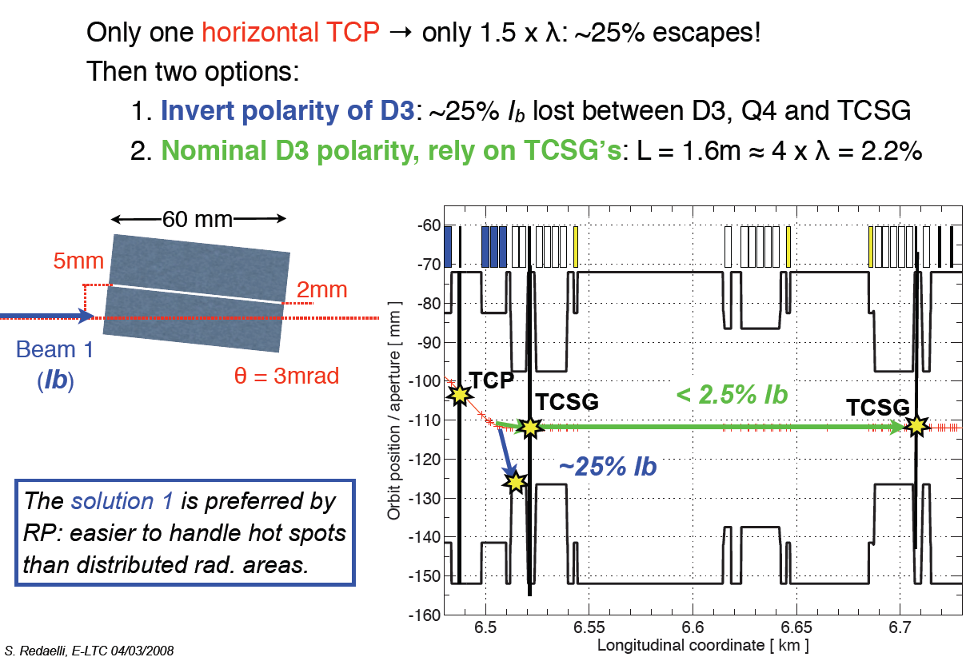
Stopping the beam in IR3

Slide 6
Beam
Stopper

Slide 7
Proposed Tests

Slide 8
Tests
Pilot Beam for the most part:
single bunch of 5 - 10 x 10⁹ protons
Total intensity:
~ 10¹³ protons
Gives a first good look at:
Full injection set-up
Instrumentation
Aperture
Field quality, polarities

Slide 9
Helmut Vincke
Radiation Protection - Summary
Areas affected by the Sector Test will be Prohibited Radiation Areas during the test.
Alice - final shielding has to be in place.
All areas in the LHC tunnel affected by the Sector Test will be classified as Radiation Area (Personal Dosimeter required) after the test.
Areas showing dose rates above 15 uSv/h will be classified as Controlled Radiation Areas (additional operational dosimeter, job and dose planning)
Material leaving the radiation zones have to be controlled and classified by RP
No significant water and air activation is expected after the Sector Test

Slide 10
Monitoring
Radiation monitoring
RAMSES operational
ALICE: 4-5 monitors planned under RAMSES
Beam Loss Monitors
Sensitive to losses at 1% level with pilot bunch intensity
Beam Intensities
Beam extracted, injected (and to dump) to be logged
RPG survey after the event and perhaps during the test to ensure that activation remains low.
Careful survey afterwards planned after the test near the injection dump and dump itself.

Slide 11
Cryogenics 1/2
For sector 23 presently under powering tests, the cryo concerns are for Q6_R2 and DFBX under consolidations, the rest is working fine
For sector 12 under LHe filling, major progress were made recently with cooling and filling DFB's and stand-alone magnets, DFBX to be consolidated
Lionel will be able to confirm the situation with at least one level gauge and few thermometers not yet in service, but with possibility to increase priority if required.
Serge Claudet

Slide 12
Cryogenics 2/2
We should be able to progress with boil-offs and various required assessments for cryo start/maintain MS_2L end of next week at best (end wk 29). We will know more about that in the coming days when we will have seen our ability to control LHe levels.
Feel free to see what could be organised, and we will make sure we follow this during the summer period.
Our concerns would be about access conditions after this possible injection test, with HWC to be completed.

Slide 13
Access – DSO tests
Goal
Nominal system deployed and tested before end July
Plan evening shifts for one week in July
2 points an evening
test doors [350] – sample or all
by-pass safety elements to avoid hitting them too often, check receipt of signals etc.
by-pass BIW
Plus one weekend of test
Resources required
Personnel for test, documentation etc.
Lots of questions: work very much in progress
Ghislain Roy

Slide 14
DSO – Injection Test
Is a reduced set of DSO tests a possiblity for an injection test?
Close whole ring
Test all doors in 2 & 3 against injection chain
Qualify rest of ring against injection chain
Condem main power supplies down-stream (block beam)
Potentially interesting option acting as useful milestone
Leverage tests performed for TI2 test

Slide 15
Other systems - briefly
Injection elements: septa, kickers | Commissioned. Check RF timing
Collimators | Lock in – no others need
TDI | Bake-out and to be hardware commissionined
Machine Protection | See following slides
Beam Instrumentation: BPMs BLMs BTV FBCT [ TI2] | 2-3 fully kitted out Sum signal?
Controls/Software | Tests in progress!
Vacuum | 2-3 Ok next week LSS2 should be OK LSS3 OK next week Sector 12…. check
ALICE | Vacuum, Injection inhibit, communication

Slide 16
Injectors

Slide 17
SPS Extraction & TI2
Jorg Wenninger
Line :
Line to TI2 TED OK – ½ hour to re-check should be fine.
End of line setup should be fast: only 1 BPM per plane (+ injection area screens) – not much to steer (+ few degrees of freedom!!)
Interlocks:
All tested up to TI2 TED.
PCs and FMCMs after TED to be tested, not critical. Maskable!
Master BIC:
Test of Probe Beam Flag with SPS beam (3rd week of July). Mandatory!
LHC Safe Beam Flag must be set (forced?) to TRUE for the test.
Test of full master logic only be done with TI2 TED out of beam → IR2 closed.

Slide 18
Injection Protection & BIC
Vacuum (last TI2 valve): Mandatory.
Operator switch: Mandatory.
ALICE injection inhibit: Mandatory.
ALICE ZDC: Mandatory.
Collimators: Nice to have. Maskable - so not a problem !
FMCM MSI & Sum Fault MSI:
PC must work of course, but interlock must not be tested before (requires IR2 closed). Test is quick in any case
All other inputs: Not activated.

Slide 19
Ring Protection
BIS
Keep BIC loops are they are. Activate only required user inputs.
Vacuum: Mandatory.
WIC: Mandatory.
PIC: Mandatory.
Requires ad-hoc PIC config → BIC + tests.
BLMs:
Connect if possible, else only observation. Unmaskable!
Collimators: Nice to have. Maskable!
FMCMs (IR3): Not needed. Maskable!
BTVs:
Expected to be ready. Must be masked if we use them!

